Slide 1


SS8H2a
Creating a
Settlement
Georgia
in
© 2014 Brain Wrinkles

Slide 2
Standards
SS8H2 The student will analyze the colonial period of Georgia’s history.
a. Explain the importance of James Oglethorpe, the Charter of 1732, reasons for settlement (charity, economics, and defense), Tomochichi, Mary Musgrove, and the city of Savannah.
© 2014 Brain Wrinkles

Slide 3
Teacher Info – Who’s & What’s
Print off the Who’s & What’s handout for each student.
BEFORE the lesson, have students fill in the squares with what they think each term means.
AFTER the presentation, the students will write down new (factual) information about each term.
Check the answers as a class.
© 2014 Brain Wrinkles

Slide 4
Who I think this is:
Definition:
What I think they were:
Definition:
Who I think this is:
Definition:
© 2014 Brain Wrinkles
Mary Musgrove
Reasons for Settling GA
James Oglethorpe
Directions: BEFORE the unit, write what you think each term means. AFTER the presentation, you will write down new information about each term.
Who’s & What’s
What I think this means:
Definition:
Who I think this is:
Definition:
What I think this means:
Definition:
Savannah
Tomochichi
Charter of 1732

Slide 5
Teacher Directions – CLOZE Notes
The next pages are handouts for the students to use for note-taking during the presentation. (Print front to back to save paper and ink.)
Check the answers as a class after the presentation.
© 2014 Brain Wrinkles

Slide 6
Oglethorpe
James Oglethorpe was a wealthy, well-educated member of ________________________________.
He was upset with the ________________________________that many of London’s citizens faced, especially those that were thrown in jail for debt.
Oglethorpe worked to ________________________________________________________ for these citizens.
In 1720, he began talking about creating a colony to _________________________________________________________ and unemployed.
Oglethorpe asked King George II for a ________________________________________________________ in 1730.
It was proposed that the new colony be called Georgia, in _________________________________________________________.
Georgia
King George liked the idea because the colony would _________________________________________________.
It would also serve as a ________________________________ between Florida (Spanish-controlled land) and the British colony of South Carolina.
In ______________, King George granted a charter that created the ________________________________ and named Oglethorpe as one of the ____________________ that would govern the new colony.
Charter of 1732
The Charter of 1732 outlined the ________________________________ Georgia:
I. Charity: The ________________________________ could apply to move to Georgia.
II. Economics: The new colony would send ________________________________ back to England for profit.
III. Defense: Georgia would ________________________________ and other colonies from the Spanish, French, and Native Americans.
Trustees
Georgia was to become a ________________________________.
The new trustees could __________________________________________ for themselves, but were allowed to give it to other people.
They could govern the colony for ________________________________, after that, the colony’s government was to pass to the ________________________________.
Colonists
Oglethorpe interviewed hundreds of people, but only accepted ________________________________ to travel to Georgia.
He only accepted people with ___________________________________________________________(tailors, carpenters, bakers, farmers, etc.).
Many British citizens supported Oglethorpe’s venture by _________________________________________________.
All colonists were given _______________________________________, tools for farming, and food to last for one year.
In return, the colonists had to agree to _____________________________________________, not sell land, grow crops, and to _________________________________________________________.
© 2014 Brain Wrinkles
Settlement CLOZE Notes

Slide 7
America
On November 17, 1732, the ______________________________________________ with Oglethorpe and 114 other people on board.
In ________________________________ , they arrived in America.
Oglethorpe selected a ______________________________________________________________for settlement.
The new city would be called ________________________________ .
Tomochichi
While scouting the new land, Oglethorpe met a group ___________________________________________ and their chief, Tomochichi.
Oglethorpe did _____________________________________________ to occur between the Indians and the colonists.
He wanted to __________________________________________ to ensure the success of the new settlement.
Mary Musgrove
Fortunately for Oglethorpe, a ________________________________ named Mary Musgrove offered to be his ________________________________ .
She served as interpreter for Oglethorpe from 1733 to 1743 and helped him _____________________________________________________________.
Musgrove helped Oglethorpe and Tomochichi work together to establish a ________________________________ .
Her ___________________________________________ to the founding of the colony of Georgia.
Savannah
In ________________________________ , Oglethorpe and the colonists ________________________________ beside the river for the new city of Savannah.
The trustees hoped that Savannah would be a “________________________________ ”.
They wanted the ________________________________ , the land holdings to be restricted, and ________________________________ in the colony.
© 2014 Brain Wrinkles
Settlement CLOZE Notes

Slide 8
Oglethorpe
James Oglethorpe was a wealthy, well-educated member of England’s Parliament.
He was upset with the harsh conditions that many of London’s citizens faced, especially those that were thrown in jail for debt.
Oglethorpe worked to improve the quality of life for these citizens.
In 1720, he began talking about creating a colony to help the country’s poor and unemployed.
Oglethorpe asked King George II for a charter of land in America in 1730.
It was proposed that the new colony be called Georgia, in honor of the king.
Georgia
King George liked the idea because the colony would help England economically.
It would also serve as a buffer colony between Florida (Spanish-controlled land) and the British colony of South Carolina.
In 1732, King George granted a charter that created the colony of Georgia and named Oglethorpe as one of the trustees that would govern the new colony.
Charter of 1732
The Charter of 1732 outlined the reasons for settling Georgia:
I. Charity: The poor and unemployed could apply to move to Georgia.
II. Economics: The new colony would send silk, wine, and indigo back to England for profit.
III. Defense: Georgia would protect South Carolina and other colonies from the Spanish, French, and Native Americans.
Trustees
Georgia was to become a trustee colony.
The new trustees could not keep any land for themselves, but were allowed to give it to other people.
They could govern the colony for 21 years, after that, the colony’s government was to pass to the ruler of England.
Colonists
Oglethorpe interviewed hundreds of people, but only accepted 35 families to travel to Georgia.
He only accepted people with skills to make Georgia a success (tailors, carpenters, bakers, farmers, etc.).
Many British citizens supported Oglethorpe’s venture by donating supplies and money.
All colonists were given 50 acres of land, tools for farming, and food to last for one year.
In return, the colonists had to agree to defend the land, not sell land, grow crops, and to obey all of the trustees’ rules.
© 2014 Brain Wrinkles
Settlement CLOZE Notes KEY

Slide 9
America
On November 17, 1732, the Anne sailed from England with Oglethorpe and 114 other people on board.
In January 1733, they arrived in America.
Oglethorpe selected a high bluff overlooking the Savannah River for settlement.
The new city would be called Savannah.
Tomochichi
While scouting the new land, Oglethorpe met a group of Yamacraw (Creek) Indians and their chief, Tomochichi.
Oglethorpe did not want any conflict to occur between the Indians and the colonists.
He wanted to negotiate fairly with Tomochichi to ensure the success of the new settlement.
Mary Musgrove
Fortunately for Oglethorpe, a part-Indian woman named Mary Musgrove offered to be his interpreter.
She served as interpreter for Oglethorpe from 1733 to 1743 and helped him work peacefully with the Creek Indians.
Musgrove helped Oglethorpe and Tomochichi work together to establish a peaceful relationship.
Her contributions were critical to the founding of the colony of Georgia.
Savannah
In February 1733, Oglethorpe and the colonists cleared the land beside the river for the new city of Savannah.
The trustees hoped that Savannah would be a “classless society”.
They wanted the houses to be similar, the land holdings to be restricted, and slavery to be forbidden in the colony.
© 2014 Brain Wrinkles
Settlement CLOZE Notes KEY

Slide 10
SS8H2a
Creating a
Settlement
Georgia
in
© 2014 Brain Wrinkles

Slide 11
Oglethorpe
James Oglethorpe was a wealthy, well-educated member of England’s Parliament.
He was upset with the harsh conditions that many of London’s citizens faced, especially those that were thrown in jail for debt.
Oglethorpe worked to improve the quality of life for these citizens.
© 2014 Brain Wrinkles

Slide 12
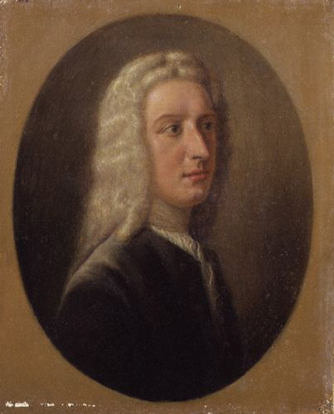
James Oglethorpe, the Founding Father of Georgia
© 2014 Brain Wrinkles

Slide 13
Oglethorpe
In 1720, he began talking about creating a colony to help the country’s poor and unemployed.
Oglethorpe asked King George II for a charter of land in America in 1730.
It was proposed that the new colony be called Georgia, in honor of the king.
© 2014 Brain Wrinkles

Slide 14
Georgia
King George liked the idea because the colony would help England economically.
It would also serve as a buffer colony between Florida (Spanish-controlled land) and the British colony of South Carolina.
In 1732, King George granted a charter that created the colony of Georgia and named Oglethorpe as one of the trustees that would govern the new colony.
© 2014 Brain Wrinkles

Slide 15
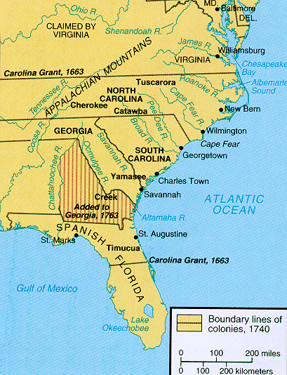
© 2014 Brain Wrinkles

Slide 16
Charter of 1732
The Charter of 1732 outlined the reasons for settling Georgia:
I. Charity: The poor and unemployed could apply to move to Georgia.
II. Economics: The new colony would send silk, wine, and indigo back to England for profit.
III. Defense: Georgia would protect South Carolina and other colonies from the Spanish, French, and Native Americans.
© 2014 Brain Wrinkles

Slide 17
Trustees
Georgia was to become a trustee colony.
The new trustees could not keep any land for themselves, but were allowed to give it to other people.
They could govern the colony for 21 years, after that, the colony’s government was to pass to the ruler of England.
© 2014 Brain Wrinkles

Slide 18
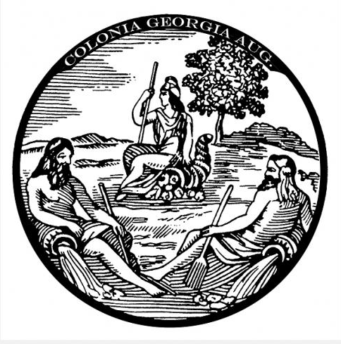
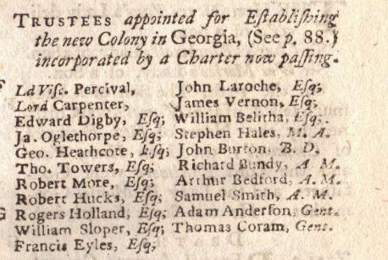
Trustees Appointed by the Charter of 1732
Seal of the Trustees
© 2014 Brain Wrinkles

Slide 19
Colonists
Oglethorpe interviewed hundreds of people, but only accepted 35 families to travel to Georgia.
He only accepted people with skills to make Georgia a success (tailors, carpenters, bakers, farmers, etc.).
Many British citizens supported Oglethorpe’s venture by donating supplies and money.
© 2014 Brain Wrinkles

Slide 20
Colonists
All colonists were given 50 acres of land, tools for farming, and food to last for one year.
In return, the colonists had to agree to defend the land, not sell land, grow crops, and to obey all of the trustees’ rules.
© 2014 Brain Wrinkles

Slide 21
America
On November 17, 1732, the Anne sailed from England with Oglethorpe and 114 other people on board.
In January 1733, they arrived in America.
Oglethorpe selected a high bluff overlooking the Savannah River for settlement.
The new city would be called Savannah.
© 2014 Brain Wrinkles

Slide 22
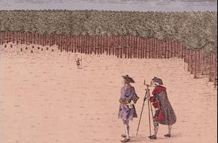
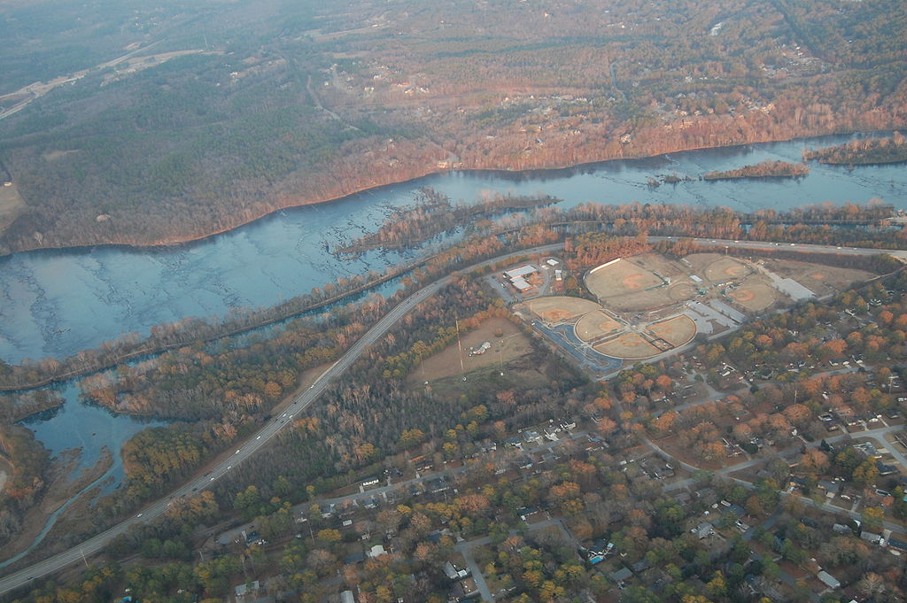
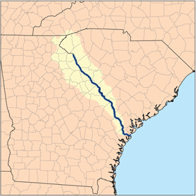
Savannah River
© 2014 Brain Wrinkles

Slide 23
Tomochichi
While scouting the new land, Oglethorpe met a group of Yamacraw (Creek) Indians and their chief, Tomochichi.
Oglethorpe did not want any conflict to occur between the Indians and the colonists.
He wanted to negotiate fairly with Tomochichi to ensure the success of the new settlement.
© 2014 Brain Wrinkles

Slide 24
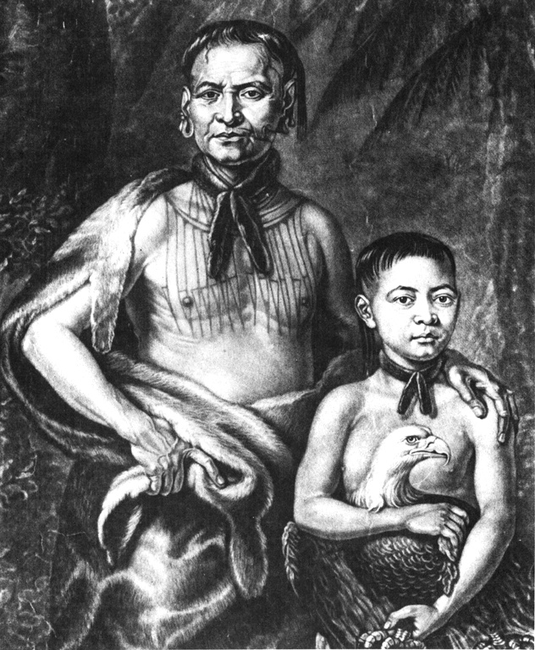
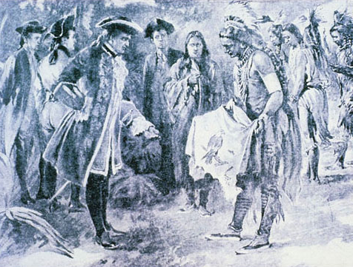
Tomochichi and Oglethorpe
Yamacraw Indian Chief, Tomochichi, and his Nephew, Toonahowi.
© 2014 Brain Wrinkles

Slide 25
Mary Musgrove
Fortunately for Oglethorpe, a part-Indian woman named Mary Musgrove offered to be his interpreter.
She served as interpreter for Oglethorpe from 1733 to 1743 and helped him work peacefully with the Creek Indians.
Musgrove helped Oglethorpe and Tomochichi work together to establish a peaceful relationship.
Her contributions were critical to the founding of the colony of Georgia.
© 2014 Brain Wrinkles

Slide 26
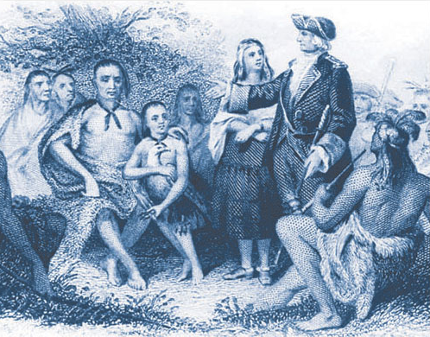
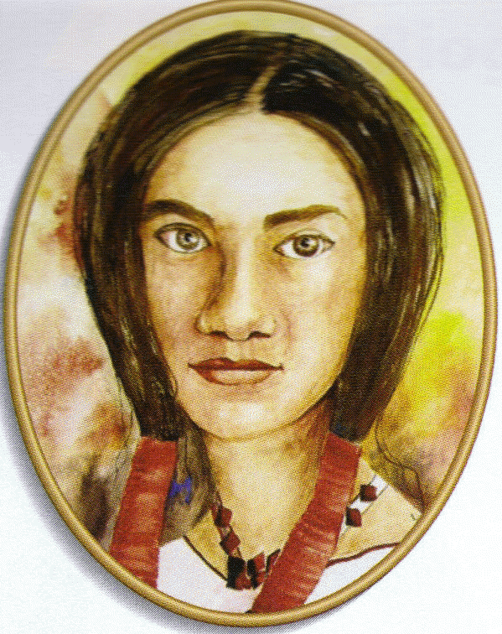
Oglethorpe, Mary Musgrove, Tomochichi, and other Yamacraw Indians
© 2014 Brain Wrinkles

Slide 27
Savannah
In February 1733, Oglethorpe and the colonists cleared the land beside the river for the new city of Savannah.
The trustees hoped that Savannah would be a “classless society”.
They wanted the houses to be similar, the land holdings to be restricted, and slavery to be forbidden in the colony.
© 2014 Brain Wrinkles

Slide 28
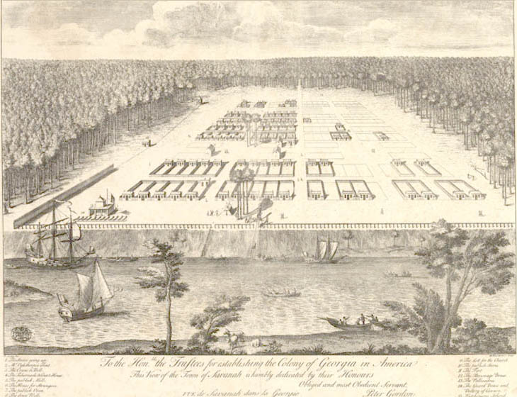
Savannah City Plan, 1734
© 2014 Brain Wrinkles

Slide 29
Teacher Info – GA Awareness T-Shirt
Print off the T-Shirt handout for each student.
Front of Shirt: The students will design a t-shirt to help spread the word about the new colony of GA. The design should share reasons why GA is a good investment for England.
Back of Shirt: They will write a persuasive paragraph that describes the shirt’s design and why donors should help fund the new settlement.
© 2014 Brain Wrinkles

Slide 30
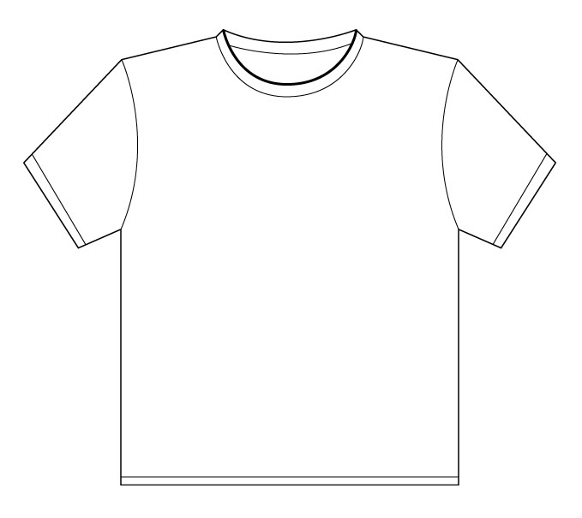
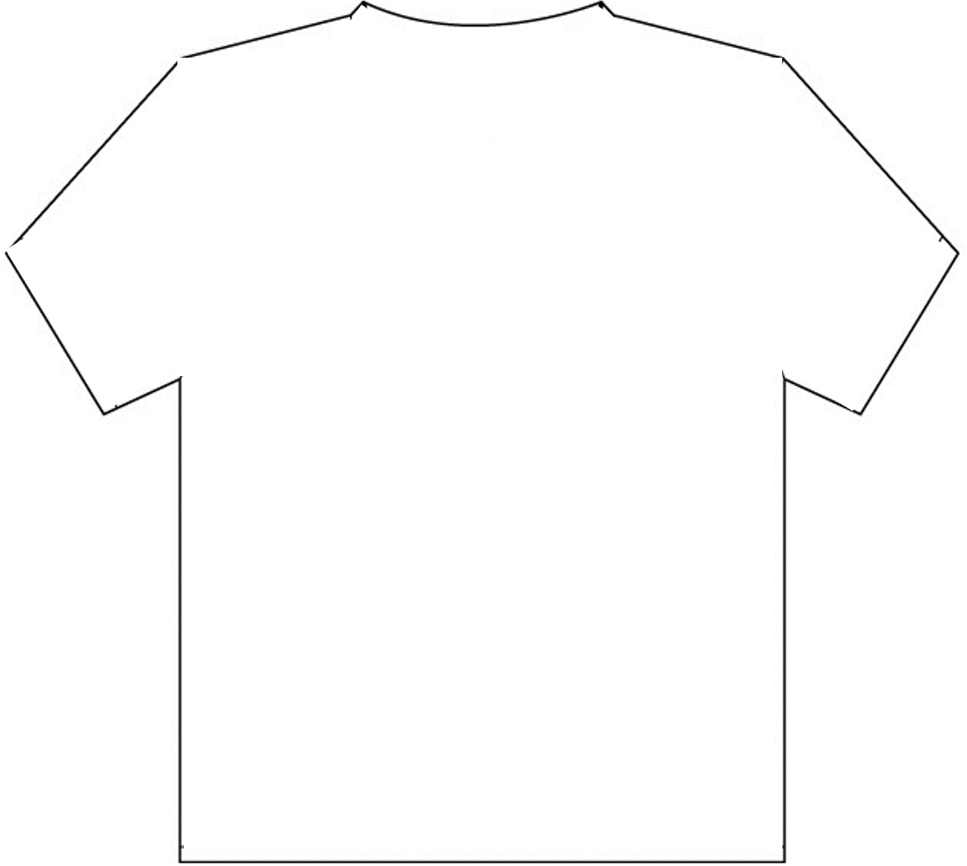
Georgia Awareness T-Shirt
Directions: Help Oglethorpe spread the word about the Charter of 1732 and the new colony of Georgia. Create a t-shirt to try to get donors to help fund the new settlement by sharing the reasons why the colony of Georgia is a good investment for England. Explain your design on the back side of the shirt.
Front
Back
© 2014 Brain Wrinkles

Slide 31
Teacher Directions - Chart
Print the Georgia VIPs graphic organizer for each student.
Students will complete the graphic organizer while discussing the presentation.
Check answers as a class at the end of the presentation to be sure that all charts are completed correctly.
© 2014 Brain Wrinkles

Slide 32
Georgia VIPs
Directions: Complete the chart below while discussing the presentation.
 | Who is this? | How was this person important to Georgia’s history? | Illustration
James Oglethorpe
Chief Tomochichi
Mary Musgrove
© 2014 Brain Wrinkles

Slide 33
Georgia VIPs - KEY
Directions: Complete the chart below while discussing the presentation.
 | Who is this? | How was this person important to Georgia’s history? | Illustration
James Oglethorpe | Wealthy member of the British parliament who wanted to help the country’s poor; came up with idea to send unemployed to a new colony in America | Asked King George for a charter of land and founded the first settlement in GA; worked peacefully with Tomochichi and the Yamacraw Indians
Chief Tomochichi | Elderly chief of the Yamacraw Indian tribe | He met Oglethorpe while O. was scouting for a place to build the settlement; he was open to a peaceful relationship with colonists; negotiated fairly with Oglethorpe
Mary Musgrove | Part-Indian woman who worked at a trading post | Agreed to be the interpreter for Oglethorpe & Yamacraw (Creek); helped him work peacefully with the Indians
© 2014 Brain Wrinkles

Slide 34
Teacher Info – Day Planner
The students will imagine that they are one of the significant people from this lesson – Oglethorpe, Tomochichi, or Musgrove.
They will create a day planner (schedule) that outlines what they will be doing each hour of the day, from the time they get up until they go to sleep.
Remind the students to think about what the person is known for and how he/she contributed to Georgia’s history when creating the schedule.
© 2014 Brain Wrinkles

Slide 35

Colonial Georgia Day Planner
Directions: Imagine you are one of the significant people from this time period (Oglethorpe, Musgrove, or Tomochichi). Create a day planner that details what you will be doing each hour of the day. Start with the hour of the day you would probably wake up and end with the hour you would probably go to sleep. Include an entry for every hour between those two events. (*Think about what how/why the people are significant to Georgia’s history.)
__________________________________________________________________________________________________________________________________________________________________________________________________________________________________________________________________________________________________________________________________________________________________________________________________________________________________________________________________________________________________________________________________________________________________________________________________________________________________________________________________________________________________________________________________________________________________________________________________________________________________________________________________________________________
__________________________________________________________________________________________________________________________________________________________________________________________________________________________________________________________________________________________________________________________________________________________________________________________________________________________________________________________________________________________________________________________________________________________________________________________________________________________________________________________________________________________________________________________________________________________________________________________________________________________________________________________________________________________
© 2014 Brain Wrinkles

Slide 36
Teacher Info – A Can for Savannah
Have the students create a can to commemorate the founding of Savannah (like the Coca-Cola cans that celebrate the Olympics).
They should include symbols to represent Oglethorpe, Charter of 1732, Tomochichi, Musgrove, etc., in their design.
In the textbox, they will write a paragraph about the can’s design and how it is significant to the founding of Savannah.
© 2014 Brain Wrinkles

Slide 37

A Can for Savannah
Directions: Design a can to commemorate the founding of Savannah, the first settlement in the new colony of Georgia. Be sure to include key people and events in your design (Oglethorpe, Musgrove, Tomochichi, Charter of 1732, etc.). In the textbox, explain your can’s design and how it is significant to the founding of Savannah.
Can Description:
© 2014 Brain Wrinkles

Slide 38
Teacher – Crystal Ball Predictions
Have students make a prediction about what life will be like in the Georgia colony over the next few years.
Have them think about Oglethorpe & the trustees, Savannah, the Spanish in Florida, etc. *This is a good lead-in to the next standard!
© 2014 Brain Wrinkles

Slide 39

Crystal Ball Predictions
Crystal Ball Predictions
What do you think life will be like in the Georgia colony over the next few years. (What happens to Oglethorpe and the trustees? Will the colonists like living in Savannah? Where are the Spanish?)
What do you think life will be like in the Georgia colony over the next few years. (What happens to Oglethorpe and the trustees? Will the colonists like living in Savannah? Where are the Spanish?)
© 2014 Brain Wrinkles
© 2014 Brain Wrinkles

Slide 40




Thank You!
Thank you so much for downloading this file. I sincerely hope you find it helpful and that your students learn a lot from it! I look forward to reading your feedback in my store.
If you like this file, you might want to check out some of my other products that teach social studies topics in creative, engaging, and hands-on ways.
Best of luck to you this school year,
Ansley at Brain Wrinkles
© 2014 Brain Wrinkles

Slide 41





Terms of Use
© 2014 Brain Wrinkles. Your download includes a limited use license from Brain Wrinkles. The purchaser may use the resource for personal classroom use only. The license is not transferable to another person. Other teachers should purchase their own license through my store.
This resource is not to be used:
By an entire grade level, school, or district without purchasing the proper number of licenses. For school/district licenses at a discount, please contact me.
As part of a product listed for sale or for free by another individual.
On shared databases.
Online in any way other than on password-protected website for student use only.
© Copyright 2014. Brain Wrinkles. All rights reserved. Permission is granted to copy pages specifically designed for student or teacher use by the original purchaser or licensee. The reproduction of any other part of this product is strictly prohibited. Copying any part of this product and placing it on the Internet in any form (even a personal/classroom website) is strictly forbidden. Doing so makes it possible for an Internet search to make the document available on the Internet, free of charge, and is a violation of the Digital Millennium Copyright Act (DMCA).
Thank you,
Ansley at Brain Wrinkles
Clipart, fonts, & digital papers for this product were purchased from:
© 2014 Brain Wrinkles

